Slide 1
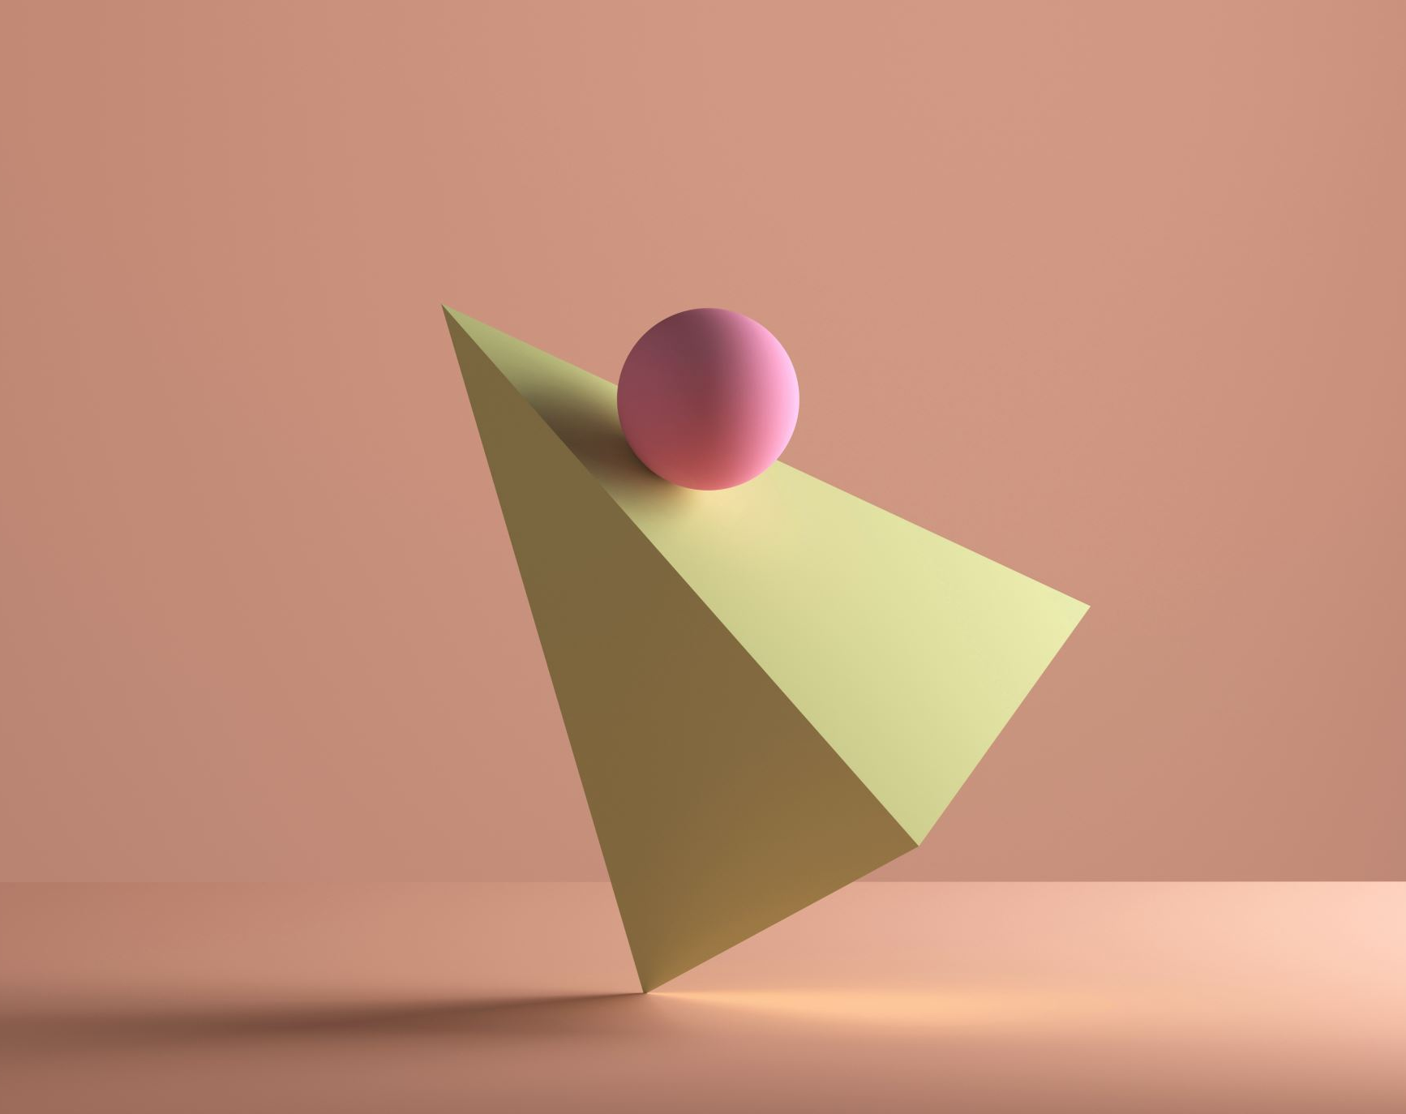
Brain Steaks
By:
Bingo Amigos

Slide 2

Info
Our project is a desktop game made using pygame and some other modules in python. It consists of puzzles, some played with pc or online with different levels of difficulty while some are two player games.

Slide 3
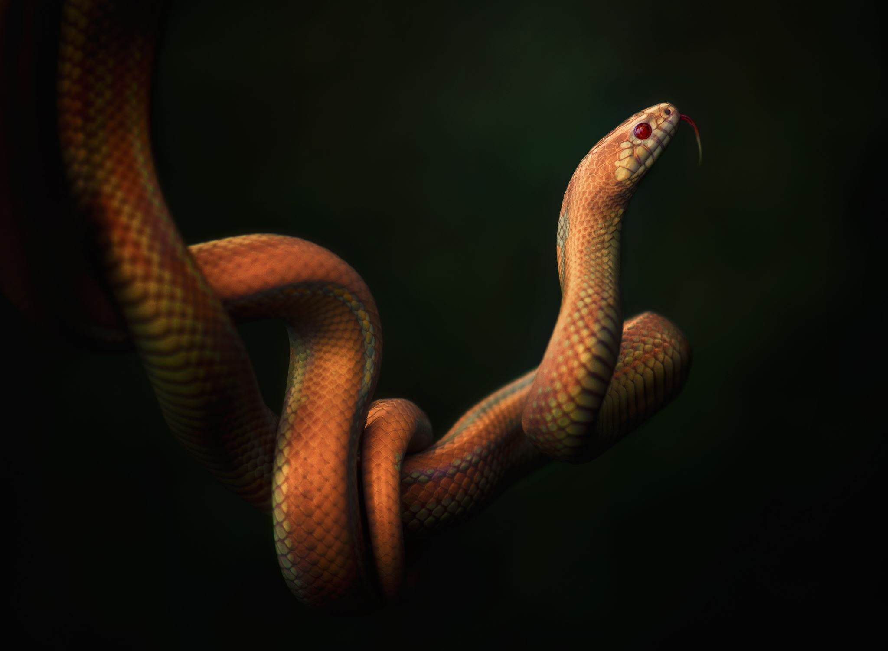
Titles
Shuffle
XOX
Sudoku
Matching Pair
Chess
Snake and Ladders

Slide 4
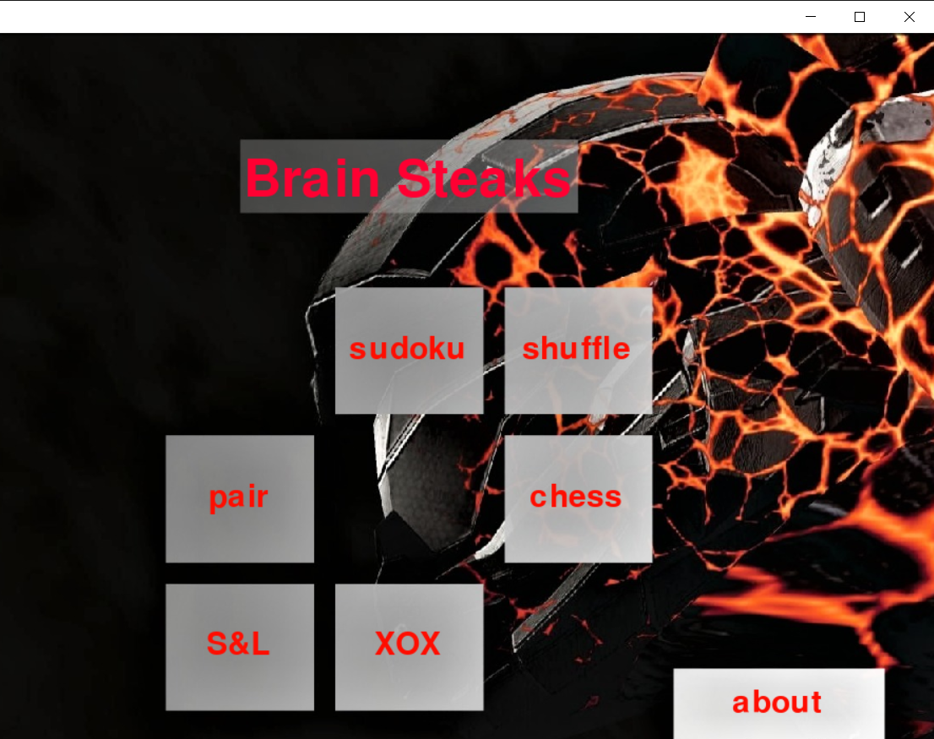
Main Page
Introduction page
This is our main page. And the options are clickable, whenever u click on any button it takes us to the corresponding game and its details.

Slide 5
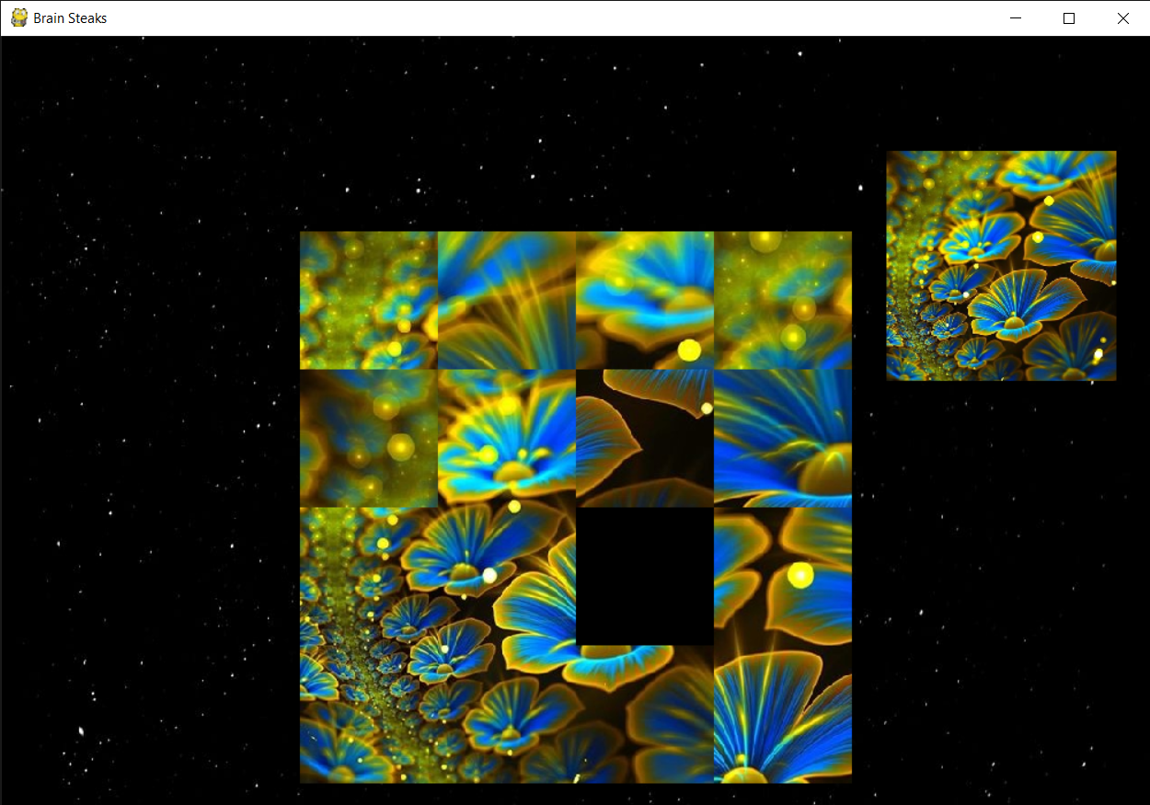
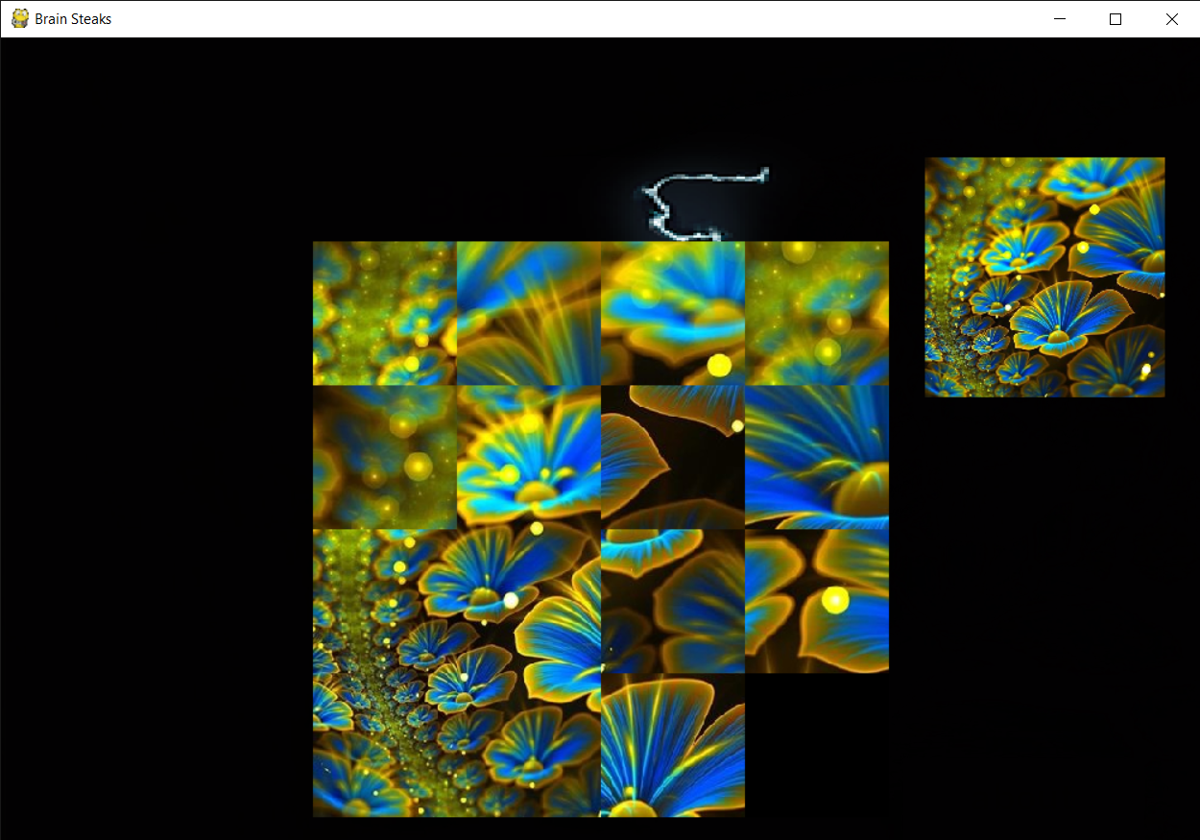
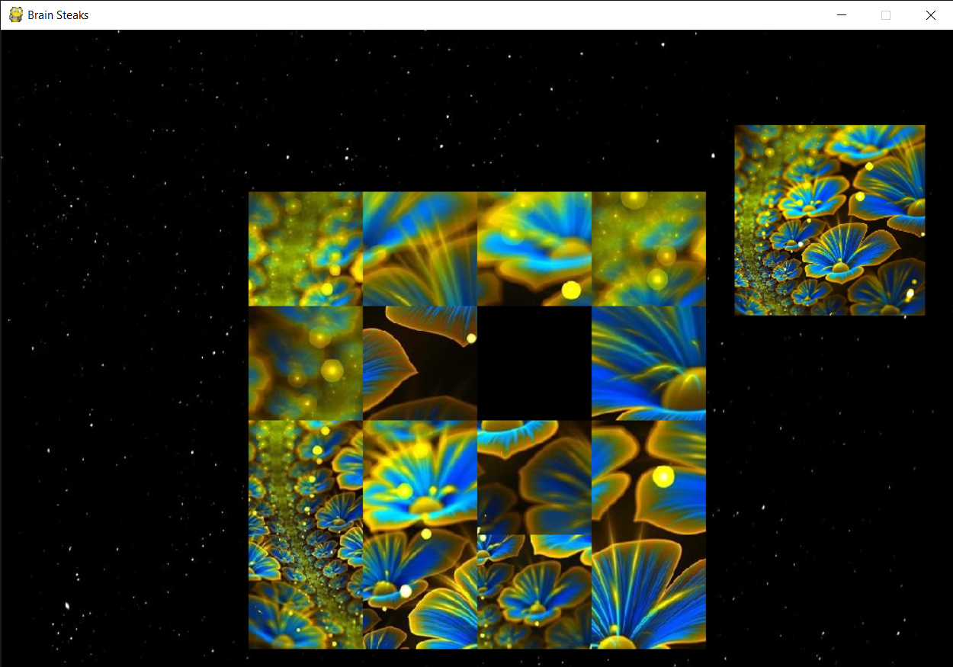
Shuffle
Whenever u click on shuffle
on main page it takes us to
shuffle game.
I hope many people remember this game.
A game in which an image is broken into parts and is shuffled and placed in a grid with one space to move in either of one direction. The player should rearrange them to form the correct picture in less number of moves. And your score will be stored in database to check best time and less moves.

Slide 6
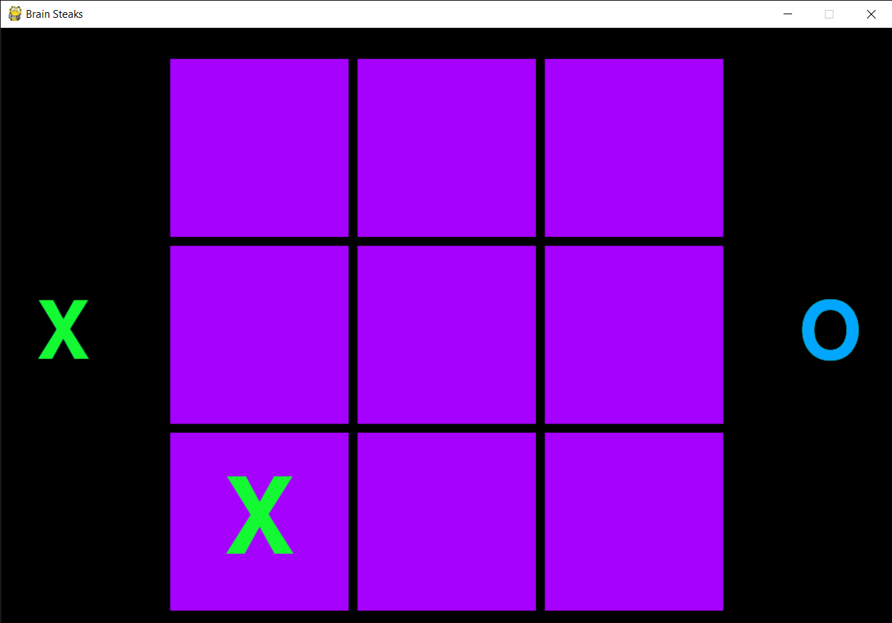
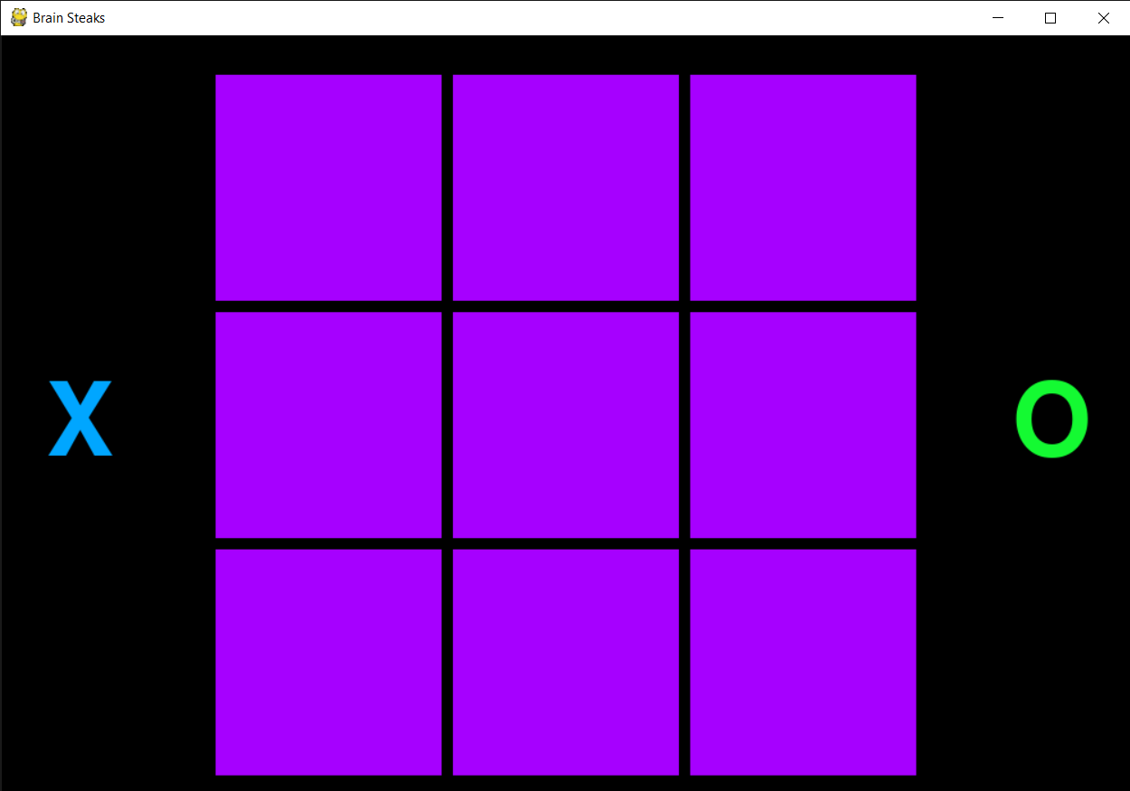
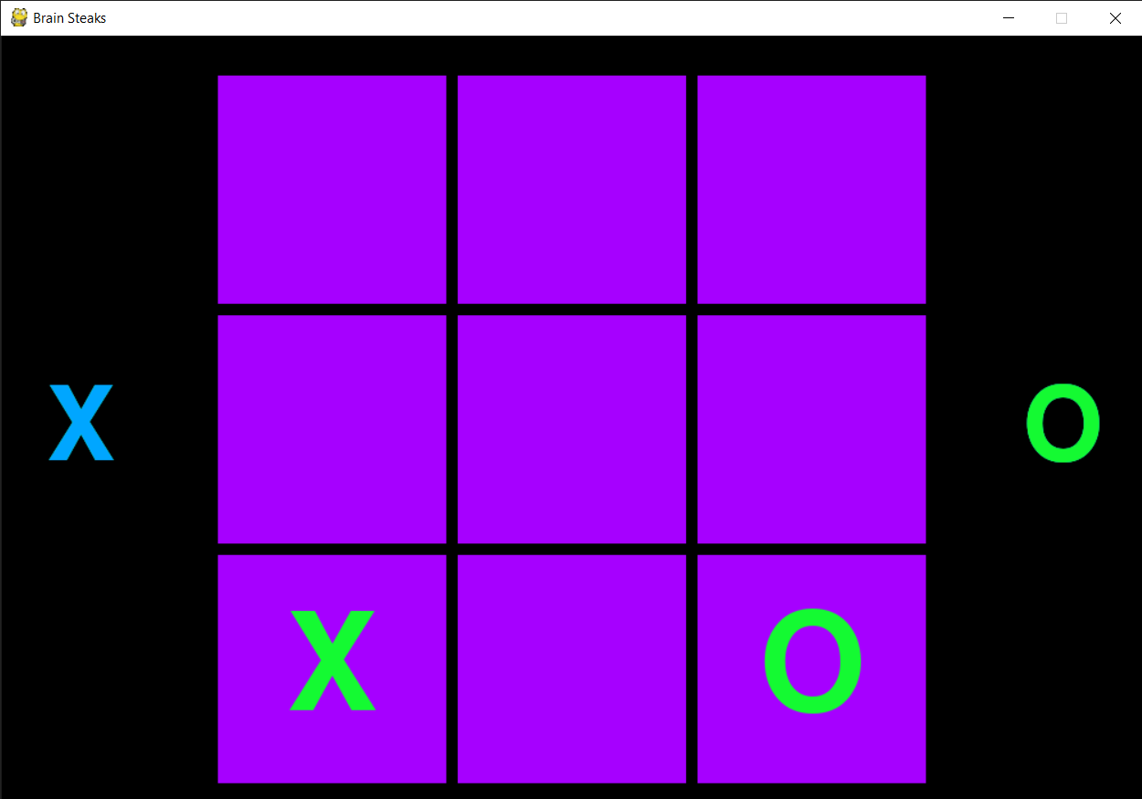
XOX
Whenever u click on XOX
on main page it takes us to
XOX game.
The normal XOX game in which 2 players play at a time or you can play against PC or can play even online(work in progress)

Slide 7
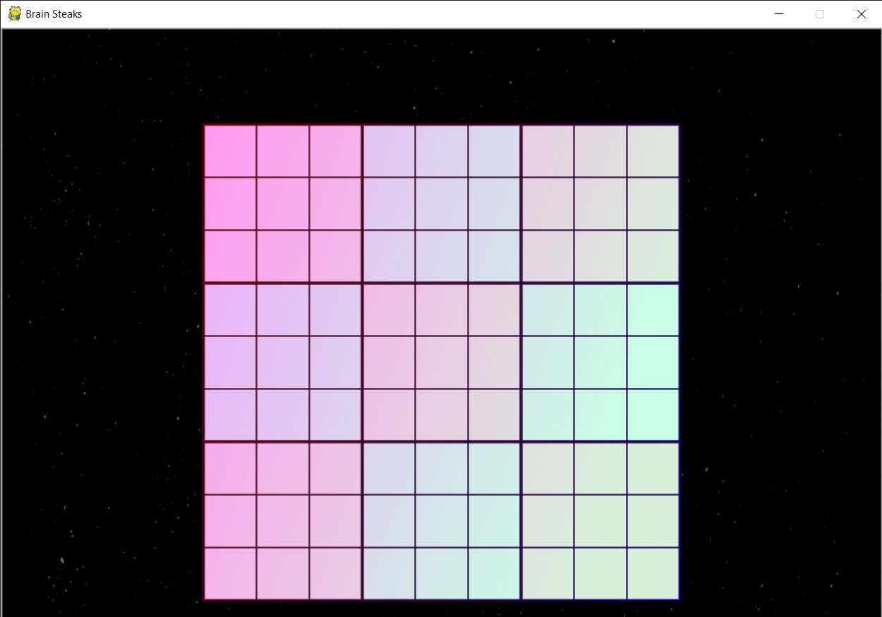
Sudoku
Whenever u click on Sudoku
on main page it takes us to
Sudoku game.
It is a matrix with 9 rows, 9 columns and 9 3*3 sub matrixes. The objective is to fill the matrix with
digits(1-9) and make sure a digit does not repeat in a row column or sub-matrix.(some cells will be pre-filled)

Slide 8
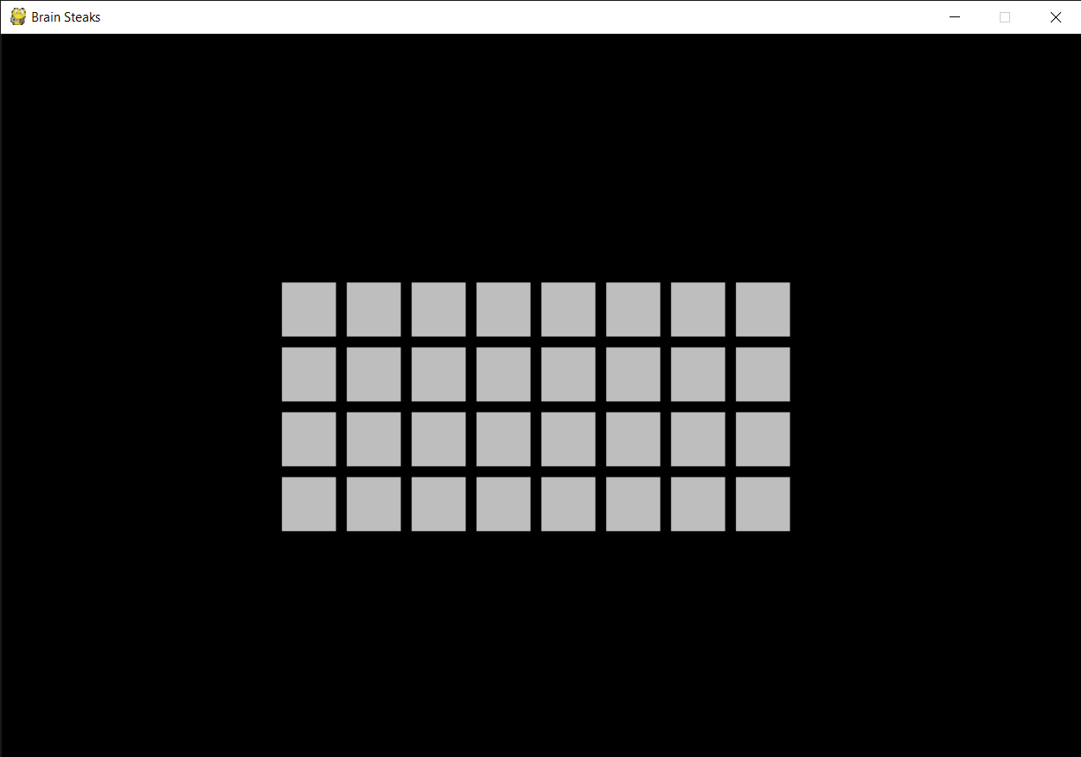
Matching Pair
Whenever u click on pair
on main page it takes us to
pair game.
some pairs of images are hidden on backsides of cards. You have to guess and use memory to find all the pairs in less number of moves

Slide 9
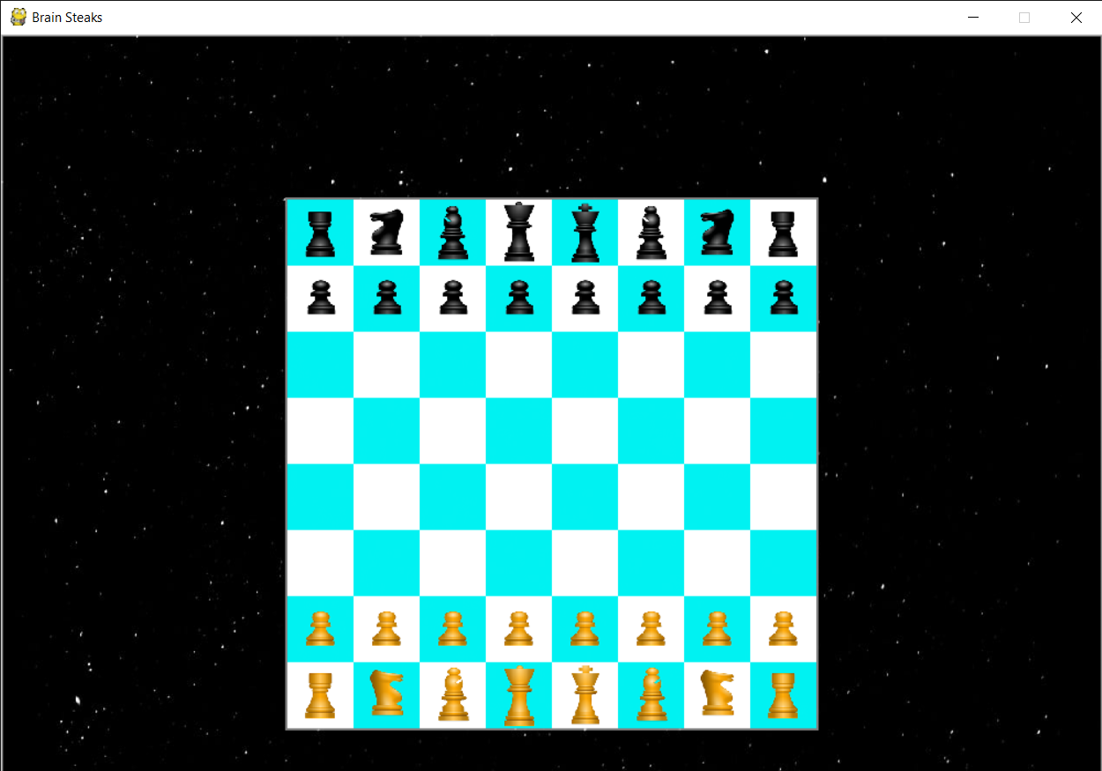
Chess
Whenever u click on Chess
on main page it takes us to
Chess game.
The normal game of chess in which 2 players can play at a time or can play with pc or via online. It is a bit hard we are trying our best to make.

Slide 10
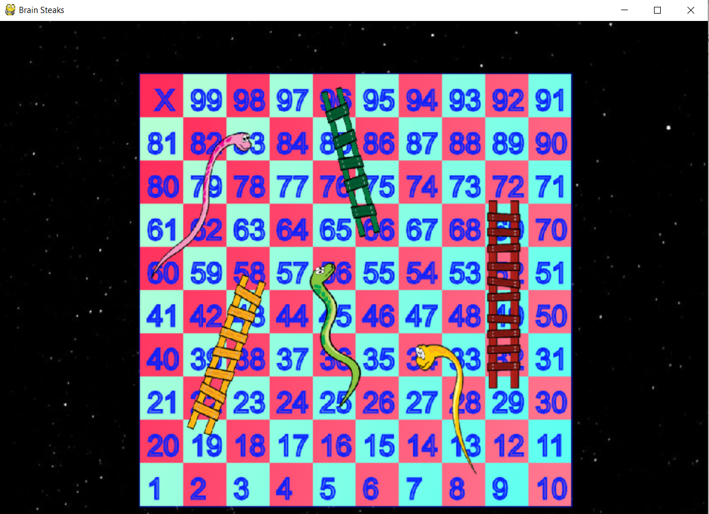
Snake And Ladders
Whenever u click on S & L
on main page it takes us to
S & L game.
The regular snake and ladder game in which 2 players play at a time or you can play against PC or through online(work in progress)

Slide 11
---------------The End--------------- Thank you sir ☺ By: Bingo Amigos Abhijith S Babu Pramodh Reddy Pokala Hisana Mohammad Basheer Satwika Penugonda

